Slide 1
Unit 1 Fundamental Concept of DBMS

Slide 2
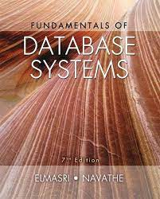

Slide 3
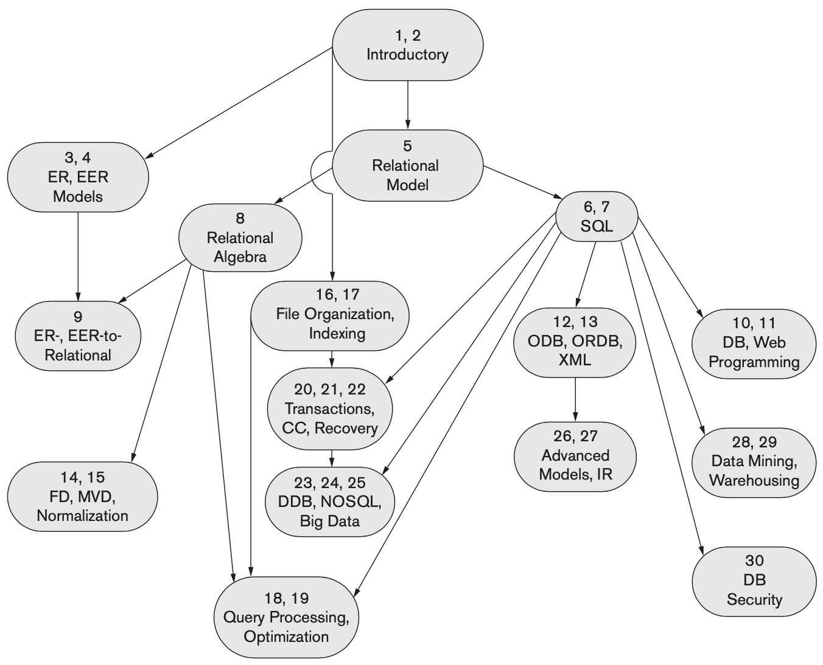
Notes:
TODO Highlight the chapters we will cover

Slide 4
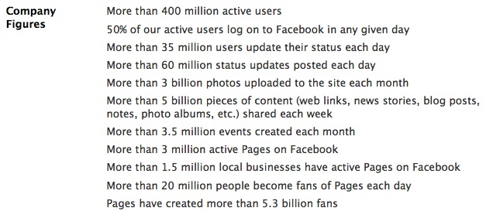

Facebook: Usage Statistics
Notes:
These statistics are outdated. Now, Facebook has nearly 3 billion active users (monthly).

Slide 5
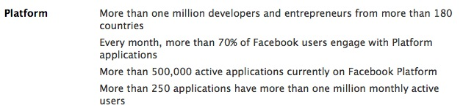
What is Facebook, anyway?
Core Applications
Profile, friends, social network, inbox, photos, groups, events, …
Platform
Enables developers to write their own Facebook applications.

Slide 6

Notes:
An aside: that platform is got them into trouble in the Cambridge Analytica scandal. CA’s app integrated w/ Facebook, and collected data from friends of users.

Slide 7
Video of Cambridge Analytica Scandal

Slide 8
How does Facebook generate your page?
Facebook is a data-driven application.
What kind of data?
Profiles, Status, Friends, Groups, Friends, Events, Photos, etc.
All of this data is stored in a database.
What’s a database?

Slide 9
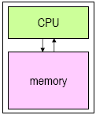
Storing Data: Memory
Memory is used to store programs and other data that are currently in use.
LOAD, STORE operations
Advantage of memory: short access times
Read/write times in nanoseconds (10⁻⁹ sec)
Disadvantages of memory:
relatively expensive
“volatile”
Notes:
Memory is used to store programs and other data that are currently in use.
Values stored in memory are read into the CPU to be operated on.
The results of operations performed by the CPU can be written back to memory.
Advantage of memory: short access times
can be read from or written to in times that are measured in nanoseconds (10⁻⁹ sec)
Disadvantages of memory:
relatively expensive
its contents are lost when the power is turned off!

Slide 10
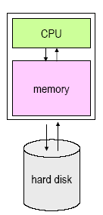
Storing Data: Secondary Storage
Secondary storage is used to store data for later use (examples: disks, CD, DVD).
Data is written from memory to disk.
When needed, data is read back into memory.

Slide 11
Secondary Storage
Advantages of secondary storage:
relatively inexpensive
not “volatile”
Disadvantage of secondary storage: long access times
Read times in milliseconds (10⁻³ sec).
in 10 ms, a modern CPU can perform millions of operations!
Thus, it's important to minimize the number of times the disk is accessed.

Slide 12
Example: Facebook Profile
What info is on a Facebook profile page?
No matter which page you view, it has these same elements…
These data are stored in a database table.
First Name
Last Name
Email
Password
Birthday
About me
Activities
Favorite Books
Favorite Movies
Favorite Music
Favorite Quotes
Favorite TV shows

Slide 13
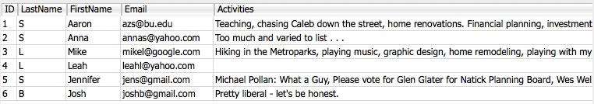
What’s a Table?
Each table (sub-collection) is a collection of records, and each record contains fields. Example: a profiles table
The primary key is a field which uniquely identifies one record within a table.
Consider this URL:
http://www.facebook.com/profile.php?id=1......

Slide 14
Primary Key
The Primary Key:
uniquely identifies a record within a table
is an ideal search key
is a way to create relationships between different tables

Slide 15

Example: Status Updates
Not all data fits neatly into the profile table. Consider status updates…
A separate Status table tracks all status updates for all users.
What fields does it need?
timestamp, userid, status

Slide 16
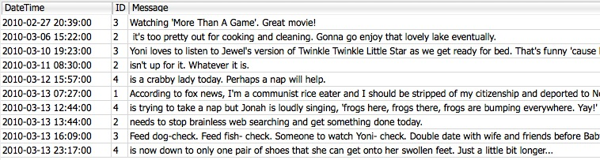
Example: Status Table
Each status message is related to exactly one profile by the foreign key (the field called ‘id’).
These ids are called a foreign key, because they are primary keys in another table.

Slide 17

Example: Friends
The Facebook “friend” relationship is created by an entry in a friend table.
Each record has two user ids:
These ids are called a foreign keys, because they are primary keys in another table.

Slide 18
Databases
A database is:
a collection of data stored in a way to enable quick access
organized into related sub-collections called tables.
Example: a mini facebook database:
A profiles table has records of each user
A status table has records of status messages
A friends table has records friend relationships
Each table (sub-collection) is organized by records, and each record contains fields.

Slide 19
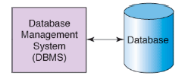
Database Management Systems
A database is a collection of data (not software).
A database management system (DBMS) is the software which manages a database.
Functions of a DBMS:
Efficient storage and access
Providing a logical view of data (tables, records)
Query processing
Transaction management

Slide 20
Function: Efficient Storage and Access
Indexing enables efficiently locating a record based on some unique attribute, called a key.
Example: looking up stocks by their symbol.
Example: update the record for symbol=‘FB’
A hash index can make these operations O(n)
A b-tree index can make these operations O(log n)
Notes:
DBMS organize data to make finding it efficient. Indexing makes it possible to find a record based on some unique attribute, called a key.
Example: looking up stocks by their symbol.
DBMS allows the user to interact with a logical representation of the data, without needing to know the details of the physical storage on disk.
Example: update the record for symbol=‘FB’.

Slide 21
Function: Logical View
Abstraction – Representing the data as tables and rows, so programmers (usually) don’t need to think about how the data is physically stored on disk (e.g., in which files?)
Notes:
DBMS organize data to make finding it efficient. Indexing makes it possible to find a record based on some unique attribute, called a key.
Example: looking up stocks by their symbol.
DBMS allows the user to interact with a logical representation of the data, without needing to know the details of the physical storage on disk.
Example: update the record for symbol=‘FB’.

Slide 22
Function: Query Processing
A query language is used to access and modify the data.
SQL (Structured Query Language) is the standard for relational databases.
Many different database vendors support SQL:
Oracle, Sybase, IBM DB2, MS SQL Server, MS Access
PostgreSQL, MySQL, SQLite (free/open-source)

Slide 23
Function: Transaction Management
“ACID” properties:
Atomicity
All of a transaction must be completed, or none of it
Consistency (Correctness)
Don’t allow the database to enter a corrupted state
Isolation
Concurrently executed transactions must have the same effects as sequentially executed transactions (since databases usually have multiple users)
Durability
After a transaction completes, it should persist even if the power fails, etc.

Slide 24
What is a Database System?
Database:
A very large collection of related data
Models a real world enterprise:
Entities (e.g., teams, games / students, courses)
Relationships (e.g., The Celtics are playing in the Final!)
Even active components (e.g. “business logic”)
DBMS: A software package/system that can be used to store, manage and retrieve data form databases
Database System: DBMS+data (+ applications)

Slide 25
Why Study Databases?
Shift from computation to information
Always true for corporate computing
More and more true in the scientific world
and of course, Web
New trend: social media generate ever increasing amount of data
DBMS encompasses much of CS in a practical discipline
OS, languages, theory, AI, logic

Slide 26
Why Study Databases?
Data Analytics is an important domain
Given large amount of data in the database, how can you use them to help you take business decisions?
Cluster based data analytics:
Map-Reduce, shared nothing DBs
Main memory databases (NVRAM)
Notes:
Removed: OLAP and Data Cube

Slide 27
Types of Databases and Database Applications
Traditional Applications:
Numeric and Textual Databases
More Recent Applications:
Multimedia Databases
Geographic Information Systems (GIS)
Data Warehouses
Real-time and Active Databases
Many other applications

Slide 28
Basic Definitions
Database:
A collection of related data.
Data:
Known facts that can be recorded and have an implicit meaning.
Mini-world:
Some part of the real world about which data is stored in a database. For example, student grades and transcripts at a university.
Database Management System (DBMS):
A software package/ system to facilitate the creation and maintenance of a computerized database.
Database System:
The DBMS software together with the data itself. Sometimes, the applications are also included.

Slide 29
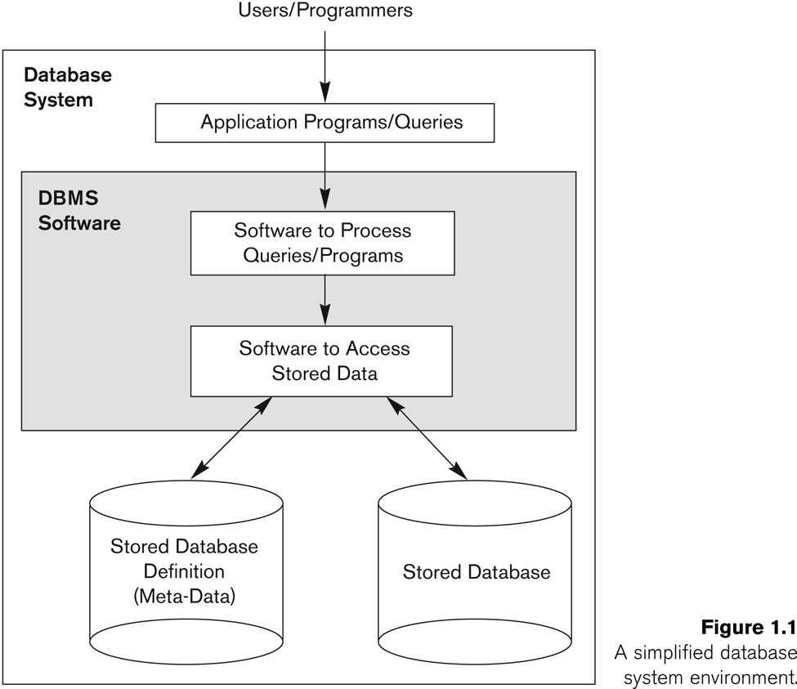
Simplified database system environment

Slide 30
Typical DBMS Functionality
Define a particular database in terms of its data types, structures, and constraints
Construct or Load the initial database contents on a secondary storage medium
Manipulating the database:
Retrieval: Querying, generating reports
Modification: Insertions, deletions and updates to its content
Accessing the database through Web applications
Processing and Sharing by a set of concurrent users and application programs – yet, keeping all data valid and consistent

Slide 31
Typical DBMS Functionality
Other features:
Protection or Security measures to prevent unauthorized access
“Active” processing to take internal actions on data
Presentation and Visualization of data
Maintaining the database and associated programs over the lifetime of the database application
Called database, software, and system maintenance

Slide 32
Example of a Database (with a Conceptual Data Model)
Mini-world for the example:
Part of a UNIVERSITY environment.
Some mini-world entities:
STUDENTs
COURSEs
SECTIONs (of COURSEs)
(academic) DEPARTMENTs
INSTRUCTORs

Slide 33
Example of a Database (with a Conceptual Data Model)
Some mini-world relationships:
SECTIONs are of specific COURSEs
STUDENTs take SECTIONs
COURSEs have prerequisite COURSEs
INSTRUCTORs teach SECTIONs
COURSEs are offered by DEPARTMENTs
STUDENTs major in DEPARTMENTs
Note: The above entities and relationships are typically expressed in a conceptual data model, such as the ENTITY-RELATIONSHIP data model (see Chapters 3, 4)

Slide 34
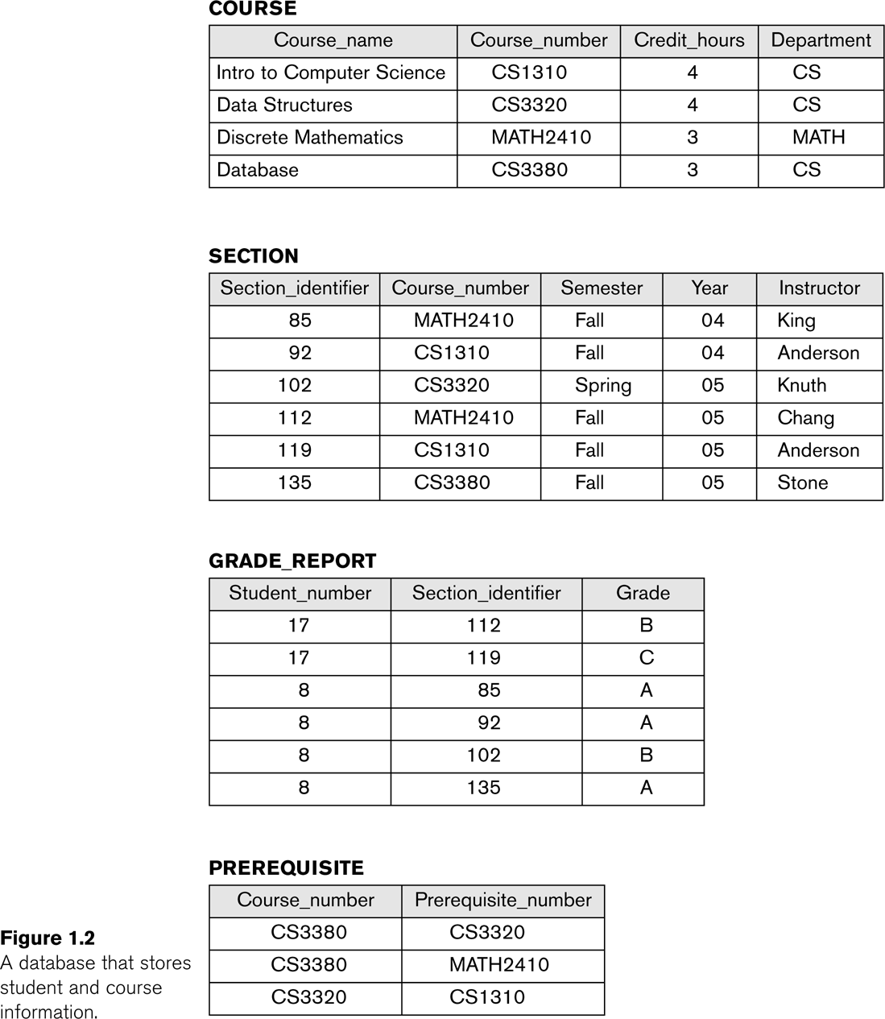
Example of a simple database

Slide 35
Main Characteristics of the Database Approach
Self-describing nature of a database system:
A DBMS catalog stores the description of a particular database (e.g. data structures, types, and constraints)
The description is called meta-data.
This allows the DBMS software to work with different database applications.
Insulation between programs and data:
Called program-data independence.
Allows changing data structures and storage organization without having to change the DBMS access programs.

Slide 36
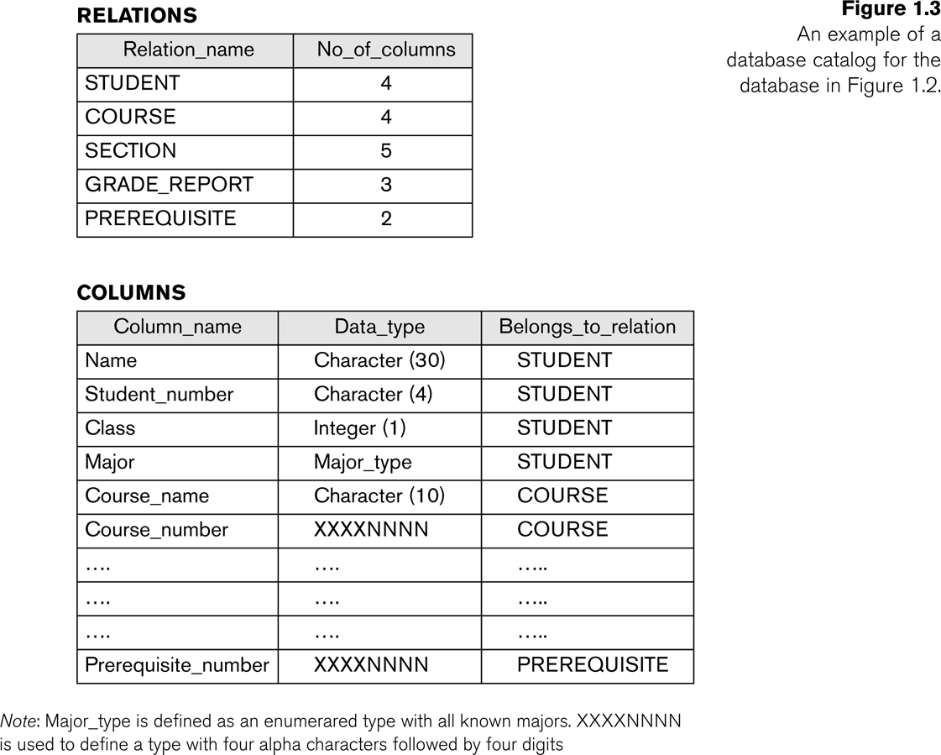
Example of a simplified database catalog

Slide 37
Main Characteristics of the Database Approach (continued)
Data Abstraction:
A data model is used to hide storage details and present the users with a conceptual view of the database.
Programs refer to the data model constructs rather than data storage details
Support of multiple views of the data:
Each user may see a different view of the database, which describes only the data of interest to that user.

Slide 38
Main Characteristics of the Database Approach (continued)
Sharing of data and multi-user transaction processing:
Allowing a set of concurrent users to retrieve from and to update the database.
Concurrency control within the DBMS guarantees that each transaction is correctly executed or aborted
Recovery subsystem ensures each completed transaction has its effect permanently recorded in the database
OLTP (Online Transaction Processing) is a major part of database applications. This allows hundreds of concurrent transactions to execute per second.

Slide 39
Database Users
Users may be divided into
Those who actually use and control the database content, and those who design, develop and maintain database applications (called “Actors on the Scene”), and
Those who design and develop the DBMS software and related tools, and the computer systems operators (called “Workers Behind the Scene”).

Slide 40
Database Users
Actors on the scene
Database administrators:
Responsible for authorizing access to the database, for coordinating and monitoring its use, acquiring software and hardware resources, controlling its use and monitoring efficiency of operations.
Database Designers:
Responsible to define the content, the structure, the constraints, and functions or transactions against the database. They must communicate with the end-users and understand their needs.

Slide 41
Categories of End-users
Actors on the scene (continued)
End-users: They use the data for queries, reports and some of them update the database content. End-users can be categorized into:
Casual: access database occasionally when needed
Naïve or Parametric: they make up a large section of the end-user population.
They use previously well-defined functions in the form of “canned transactions” against the database.
Examples are bank-tellers or reservation clerks who do this activity for an entire shift of operations.

Slide 42
Categories of End-users (continued)
Sophisticated:
These include business analysts, scientists, engineers, others thoroughly familiar with the system capabilities.
Many use tools in the form of software packages that work closely with the stored database.
Stand-alone:
Mostly maintain personal databases using ready-to-use packaged applications.
An example is a tax program user that creates its own internal database.
Another example is a user that maintains an address book

Slide 43
Advantages of Using the Database Approach
Controlling redundancy in data storage and in development and maintenance efforts.
Sharing of data among multiple users.
Restricting unauthorized access to data.
Providing persistent storage for program Objects
In Object-oriented DBMSs – see Chapters 20-22
Providing Storage Structures (e.g. indexes) for efficient Query Processing

Slide 44
Advantages of Using the Database Approach (continued)
Providing backup and recovery services.
Providing multiple interfaces to different classes of users.
Representing complex relationships among data.
Enforcing integrity constraints on the database.
Drawing inferences and actions from the stored data using deductive and active rules

Slide 45
Additional Implications of Using the Database Approach
Potential for enforcing standards:
This is very crucial for the success of database applications in large organizations. Standards refer to data item names, display formats, screens, report structures, meta-data (description of data), Web page layouts, etc.
Reduced application development time:
Incremental time to add each new application is reduced.

Slide 46
Additional Implications of Using the Database Approach (continued)
Flexibility to change data structures:
Database structure may evolve as new requirements are defined.
Availability of current information:
Extremely important for on-line transaction systems such as airline, hotel, car reservations.
Economies of scale:
Wasteful overlap of resources and personnel can be avoided by consolidating data and applications across departments.

Slide 47
Historical Development of Database Technology
Early Database Applications:
The Hierarchical and Network Models were introduced in mid 1960s and dominated during the seventies.
A bulk of the worldwide database processing still occurs using these models, particularly, the hierarchical model.
Relational Model based Systems:
Relational model was originally introduced in 1970, was heavily researched and experimented within IBM Research and several universities.
Relational DBMS Products emerged in the early 1980s.

Slide 48
Historical Development of Database Technology (continued)
Object-oriented and emerging applications:
Object-Oriented Database Management Systems (OODBMSs) were introduced in late 1980s and early 1990s to cater to the need of complex data processing in CAD and other applications.
Their use has not taken off much.
Many relational DBMSs have incorporated object database concepts, leading to a new category called object-relational DBMSs (ORDBMSs)
Extended relational systems add further capabilities (e.g. for multimedia data, XML, and other data types)

Slide 49
Historical Development of Database Technology (continued)
Data on the Web and E-commerce Applications:
Web contains data in HTML (Hypertext markup language) with links among pages.
This has given rise to a new set of applications and E-commerce is using new standards like XML (eXtended Markup Language). (see Ch. 27).
Script programming languages such as PHP and JavaScript allow generation of dynamic Web pages that are partially generated from a database (see Ch. 26).
Also allow database updates through Web pages

Slide 50
Extending Database Capabilities
New functionality is being added to DBMSs in the following areas:
Scientific Applications
XML (eXtensible Markup Language)
Image Storage and Management
Audio and Video Data Management
Data Warehousing and Data Mining
Spatial Data Management
Time Series and Historical Data Management
The above gives rise to new research and development in incorporating new data types, complex data structures, new operations and storage and indexing schemes in database systems.

Slide 51
When not to use a DBMS
Main inhibitors (costs) of using a DBMS:
High initial investment and possible need for additional hardware.
Overhead for providing generality, security, concurrency control, recovery, and integrity functions.
When a DBMS may be unnecessary:
If the database and applications are simple, well defined, and not expected to change.
If there are stringent real-time requirements that may not be met because of DBMS overhead.
If access to data by multiple users is not required.

Slide 52
When not to use a DBMS
When no DBMS may suffice:
If the database system is not able to handle the complexity of data because of modeling limitations
If the database users need special operations not supported by the DBMS.

Slide 53
Entity Relationship Diagram (ERD)
Overview of Database Design Process
Example Database Application (COMPANY)
ER Model Concepts
Entities and Attributes
Entity Types, Value Sets, and Key Attributes
Relationships and Relationship Types
Weak Entity Types
Roles and Attributes in Relationship Types
ER Diagrams - Notation
ER Diagram for COMPANY Schema
Alternative Notations – UML class diagrams, others

Slide 54
Overview of Database Design Process
Two main activities:
Database design
Applications design
Focus in this chapter on database design
To design the conceptual schema for a database application
Applications design focuses on the programs and interfaces that access the database
Generally considered part of software engineering

Slide 55
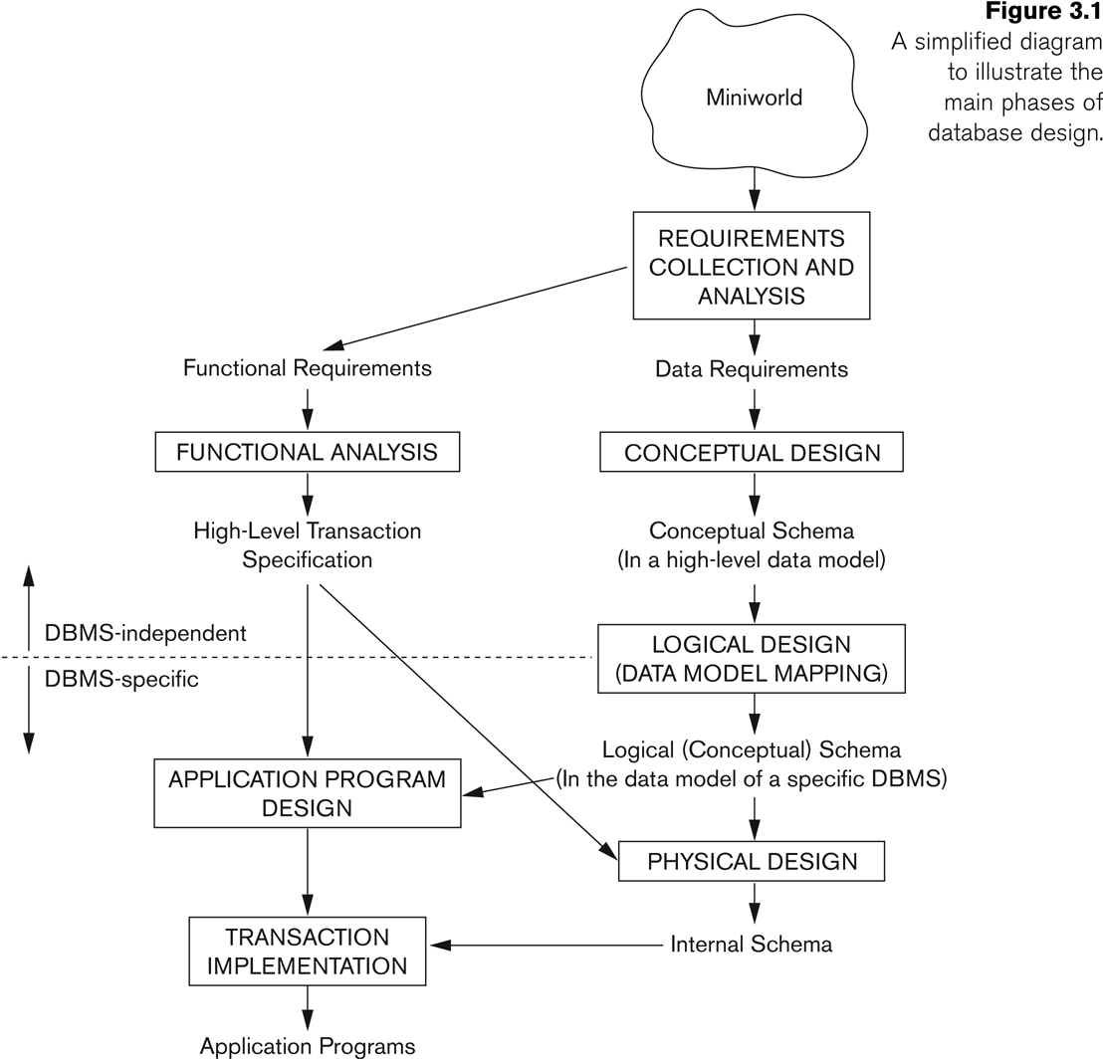
Overview of Database Design Process

Slide 56
Example COMPANY Database
We need to create a database schema design based on the following (simplified) requirements of the COMPANY Database:
The company is organized into DEPARTMENTs. Each department has a name, number and an employee who manages the department. We keep track of the start date of the department manager. A department may have several locations.
Each department controls a number of PROJECTs. Each project has a unique name, unique number and is located at a single location.

Slide 57
Example COMPANY Database (Contd.)
We store each EMPLOYEE’s social security number, address, salary, sex, and birthdate.
Each employee works for one department but may work on several projects.
We keep track of the number of hours per week that an employee currently works on each project.
We also keep track of the direct supervisor of each employee.
Each employee may have a number of DEPENDENTs.
For each dependent, we keep track of their name, sex, birthdate, and relationship to the employee.

Slide 58
ER Model Concepts
Entities and Attributes
Entities are specific objects or things in the mini-world that are represented in the database.
For example the EMPLOYEE John Smith, the Research DEPARTMENT, the ProductX PROJECT
Attributes are properties used to describe an entity.
For example an EMPLOYEE entity may have the attributes Name, SSN, Address, Sex, BirthDate
A specific entity will have a value for each of its attributes.
For example a specific employee entity may have Name='John Smith', SSN='123456789', Address ='731, Fondren, Houston, TX', Sex='M', BirthDate='09-JAN-55‘
Each attribute has a value set (or data type) associated with it – e.g. integer, string, subrange, enumerated type, …

Slide 59
Types of Attributes (1)
Simple
Each entity has a single atomic value for the attribute. For example, SSN or Sex.
Composite
The attribute may be composed of several components. For example:
Address(Apt#, House#, Street, City, State, ZipCode, Country), or
Name(FirstName, MiddleName, LastName).
Composition may form a hierarchy where some components are themselves composite.
Multi-valued
An entity may have multiple values for that attribute. For example, Color of a CAR or PreviousDegrees of a STUDENT.
Denoted as {Color} or {PreviousDegrees}.

Slide 60
Types of Attributes (2)
In general, composite and multi-valued attributes may be nested arbitrarily to any number of levels, although this is rare.
For example, PreviousDegrees of a STUDENT is a composite multi-valued attribute denoted by {PreviousDegrees (College, Year, Degree, Field)}
Multiple PreviousDegrees values can exist
Each has four subcomponent attributes:
College, Year, Degree, Field

Slide 61
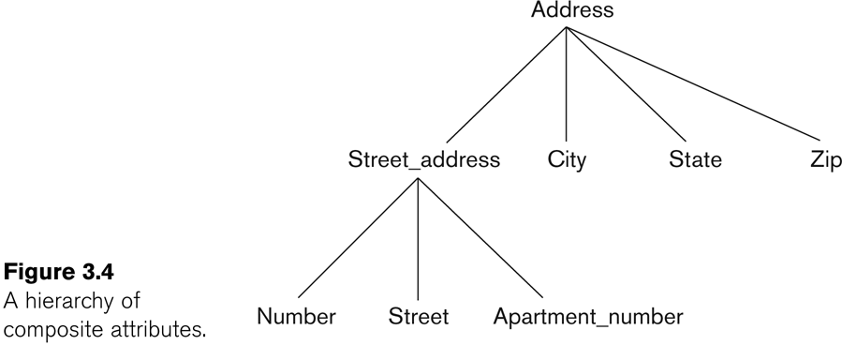
Example of a composite attribute

Slide 62
Entity Types and Key Attributes (1)
Entities with the same basic attributes are grouped or typed into an entity type.
For example, the entity type EMPLOYEE and PROJECT.
An attribute of an entity type for which each entity must have a unique value is called a key attribute of the entity type.
For example, SSN of EMPLOYEE.

Slide 63
Entity Types and Key Attributes (2)
A key attribute may be composite.
VehicleTagNumber is a key of the CAR entity type with components (Number, State).
An entity type may have more than one key.
The CAR entity type may have two keys:
VehicleIdentificationNumber (popularly called VIN)
VehicleTagNumber (Number, State), aka license plate number.
Each key is underlined

Slide 64
Displaying an Entity type
In ER diagrams, an entity type is displayed in a rectangular box
Attributes are displayed in ovals
Each attribute is connected to its entity type
Components of a composite attribute are connected to the oval representing the composite attribute
Each key attribute is underlined
Multivalued attributes displayed in double ovals
See CAR example on next slide

Slide 65
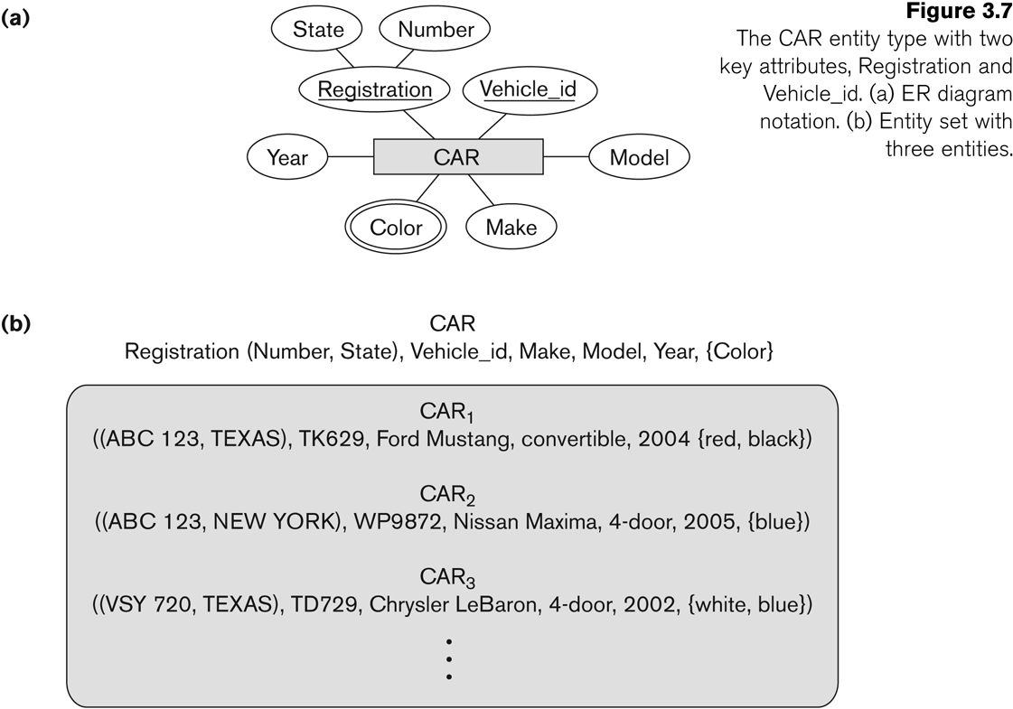
Entity Type CAR with two keys and a corresponding Entity Set

Slide 66
Entity Set
Each entity type will have a collection of entities stored in the database
Called the entity set
Previous slide shows three CAR entity instances in the entity set for CAR
Same name (CAR) used to refer to both the entity type and the entity set
Entity set is the current state of the entities of that type that are stored in the database

Slide 67
Initial Design of Entity Types for the COMPANY Database Schema
Based on the requirements, we can identify four initial entity types in the COMPANY database:
DEPARTMENT
PROJECT
EMPLOYEE
DEPENDENT
Their initial design is shown on the following slide
The initial attributes shown are derived from the requirements description

Slide 68
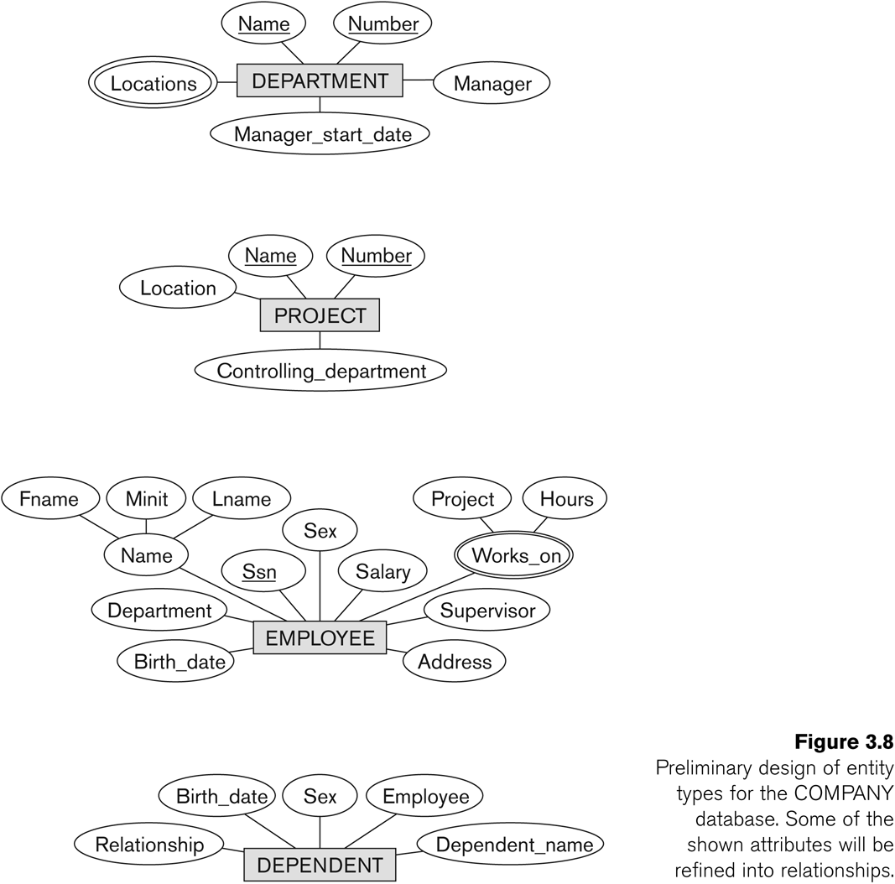
Initial Design of Entity Types: EMPLOYEE, DEPARTMENT, PROJECT, DEPENDENT

Slide 69
Refining the initial design by introducing relationships
The initial design is typically not complete
Some aspects in the requirements will be represented as relationships
ER model has three main concepts:
Entities (and their entity types and entity sets)
Attributes (simple, composite, multivalued)
Relationships (and their relationship types and relationship sets)
We introduce relationship concepts next

Slide 70
Relationships and Relationship Types (1)
A relationship relates two or more distinct entities with a specific meaning.
For example, EMPLOYEE John Smith works on the ProductX PROJECT, or EMPLOYEE Franklin Wong manages the Research DEPARTMENT.
Relationships of the same type are grouped or typed into a relationship type.
For example, the WORKS_ON relationship type in which EMPLOYEEs and PROJECTs participate, or the MANAGES relationship type in which EMPLOYEEs and DEPARTMENTs participate.
The degree of a relationship type is the number of participating entity types.
Both MANAGES and WORKS_ON are binary relationships.

Slide 71
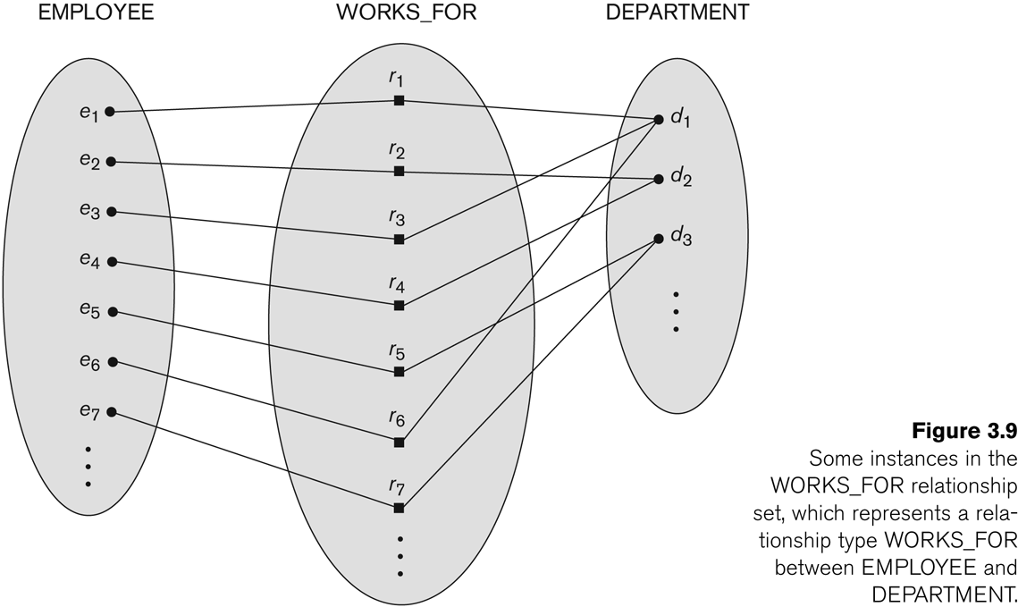
Relationship instances of the WORKS_FOR N:1 relationship between EMPLOYEE and DEPARTMENT

Slide 72
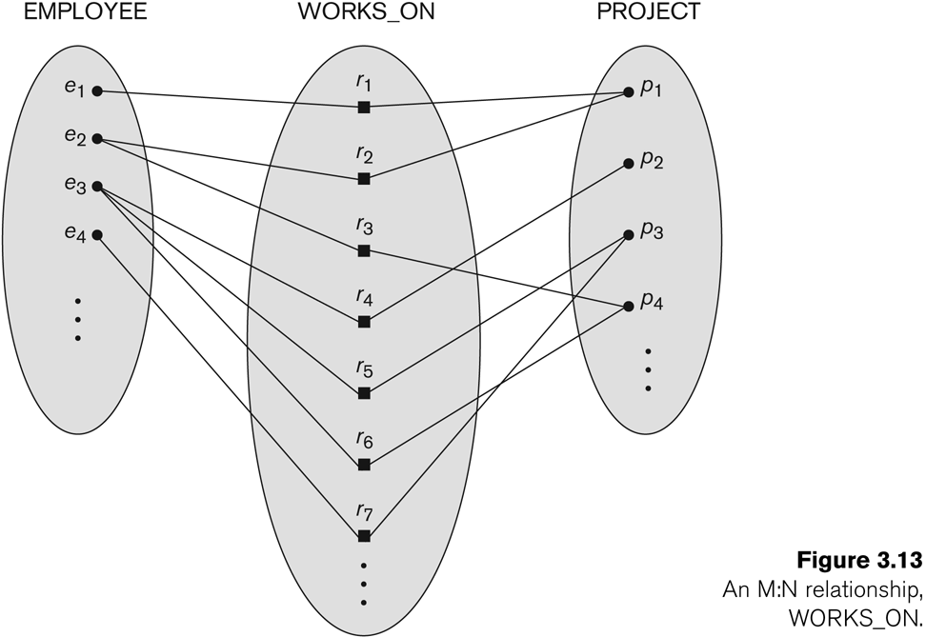
Relationship instances of the M:N WORKS_ON relationship between EMPLOYEE and PROJECT

Slide 73
Relationship type vs. relationship set (1)
Relationship Type:
Is the schema description of a relationship
Identifies the relationship name and the participating entity types
Also identifies certain relationship constraints
Relationship Set:
The current set of relationship instances represented in the database
The current state of a relationship type

Slide 74
Relationship type vs. relationship set (2)
Previous figures displayed the relationship sets
Each instance in the set relates individual participating entities – one from each participating entity type
In ER diagrams, we represent the relationship type as follows:
Diamond-shaped box is used to display a relationship type
Connected to the participating entity types via straight lines

Slide 75
Refining the COMPANY database schema by introducing relationships
By examining the requirements, six relationship types are identified
All are binary relationships( degree 2)
Listed below with their participating entity types:
WORKS_FOR (between EMPLOYEE, DEPARTMENT)
MANAGES (also between EMPLOYEE, DEPARTMENT)
CONTROLS (between DEPARTMENT, PROJECT)
WORKS_ON (between EMPLOYEE, PROJECT)
SUPERVISION (between EMPLOYEE (as subordinate), EMPLOYEE (as supervisor))
DEPENDENTS_OF (between EMPLOYEE, DEPENDENT)

Slide 76
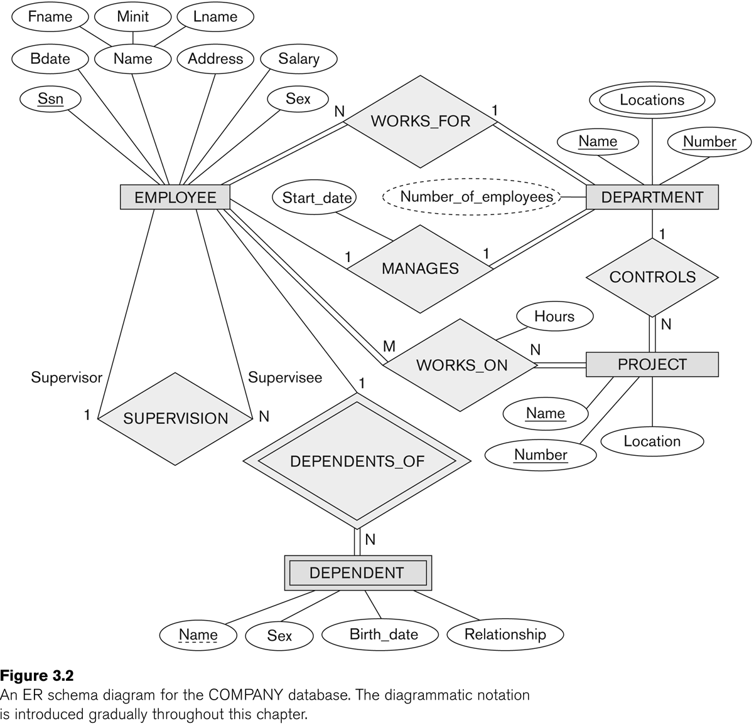
ER DIAGRAM – Relationship Types are: WORKS_FOR, MANAGES, WORKS_ON, CONTROLS, SUPERVISION, DEPENDENTS_OF

Slide 77
Discussion on Relationship Types
In the refined design, some attributes from the initial entity types are refined into relationships:
Manager of DEPARTMENT -> MANAGES
Works_on of EMPLOYEE -> WORKS_ON
Department of EMPLOYEE -> WORKS_FOR
etc
In general, more than one relationship type can exist between the same participating entity types
MANAGES and WORKS_FOR are distinct relationship types between EMPLOYEE and DEPARTMENT
Different meanings and different relationship instances.

Slide 78
Recursive Relationship Type
An relationship type whose with the same participating entity type in distinct roles
Example: the SUPERVISION relationship
EMPLOYEE participates twice in two distinct roles:
supervisor (or boss) role
supervisee (or subordinate) role
Each relationship instance relates two distinct EMPLOYEE entities:
One employee in supervisor role
One employee in supervisee role

Slide 79
Weak Entity Types
An entity that does not have a key attribute
A weak entity must participate in an identifying relationship type with an owner or identifying entity type
Entities are identified by the combination of:
A partial key of the weak entity type
The particular entity they are related to in the identifying entity type
Example:
A DEPENDENT entity is identified by the dependent’s first name, and the specific EMPLOYEE with whom the dependent is related
Name of DEPENDENT is the partial key
DEPENDENT is a weak entity type
EMPLOYEE is its identifying entity type via the identifying relationship type DEPENDENT_OF

Slide 80
Constraints on Relationships
Constraints on Relationship Types
(Also known as ratio constraints)
Cardinality Ratio (specifies maximum participation)
One-to-one (1:1)
One-to-many (1:N) or Many-to-one (N:1)
Many-to-many (M:N)
Existence Dependency Constraint (specifies minimum participation) (also called participation constraint)
zero (optional participation, not existence-dependent)
one or more (mandatory participation, existence-dependent)

Slide 81
Many-to-one (N:1) Relationship

Slide 82
Many-to-many (M:N) Relationship

Slide 83
Displaying a recursive relationship
In a recursive relationship type.
Both participations are same entity type in different roles.
For example, SUPERVISION relationships between EMPLOYEE (in role of supervisor or boss) and (another) EMPLOYEE (in role of subordinate or worker).
In following figure, first role participation labeled with 1 and second role participation labeled with 2.
In ER diagram, need to display role names to distinguish participations.

Slide 84
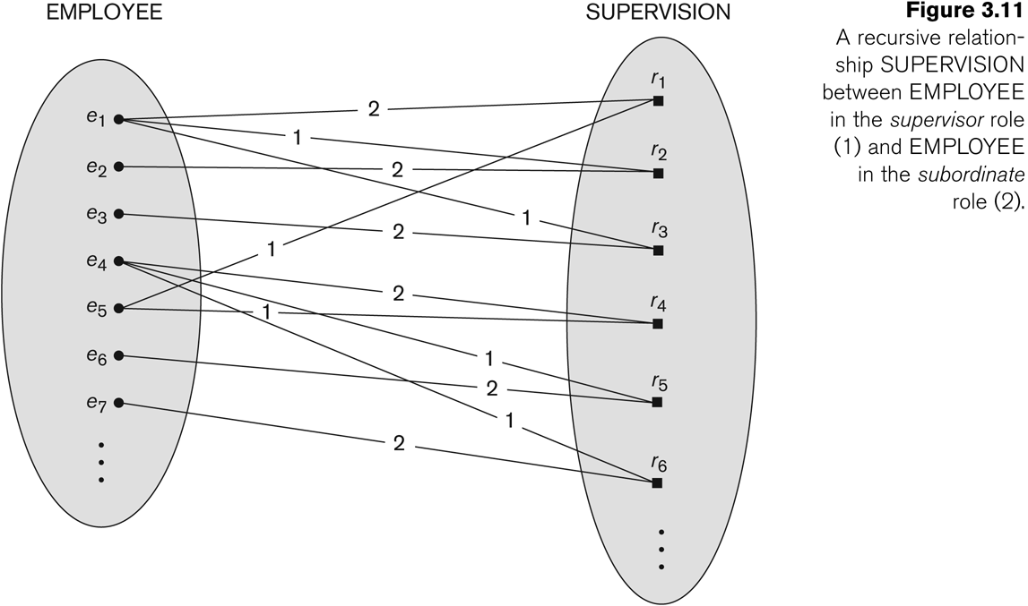
A Recursive Relationship Supervision`

Slide 85
Recursive Relationship Type is: SUPERVISION (participation role names are shown)

Slide 86
Attributes of Relationship types
A relationship type can have attributes:
For example, HoursPerWeek of WORKS_ON
Its value for each relationship instance describes the number of hours per week that an EMPLOYEE works on a PROJECT.
A value of HoursPerWeek depends on a particular (employee, project) combination
Most relationship attributes are used with M:N relationships
In 1:N relationships, they can be transferred to the entity type on the N-side of the relationship

Slide 87
Example Attribute of a Relationship Type: Hours of WORKS_ON

Slide 88
Notation for Constraints on Relationships
Cardinality ratio (of a binary relationship): 1:1, 1:N, N:1, or M:N
Shown by placing appropriate numbers on the relationship edges.
Participation constraint (on each participating entity type): total (called existence dependency) or partial.
Total shown by double line, partial by single line.
NOTE: These are easy to specify for Binary Relationship Types.

Slide 89
Alternative (min, max) notation for relationship structural constraints:
Specified on each participation of an entity type E in a relationship type R
Specifies that each entity e in E participates in at least min and at most max relationship instances in R
Default(no constraint): min=0, max=n (signifying no limit)
Must have min≤max, min≥0, max ≥1
Derived from the knowledge of mini-world constraints
Examples:
A department has exactly one manager and an employee can manage at most one department.
Specify (0,1) for participation of EMPLOYEE in MANAGES
Specify (1,1) for participation of DEPARTMENT in MANAGES
An employee can work for exactly one department but a department can have any number of employees.
Specify (1,1) for participation of EMPLOYEE in WORKS_FOR
Specify (0,n) for participation of DEPARTMENT in WORKS_FOR

Slide 90
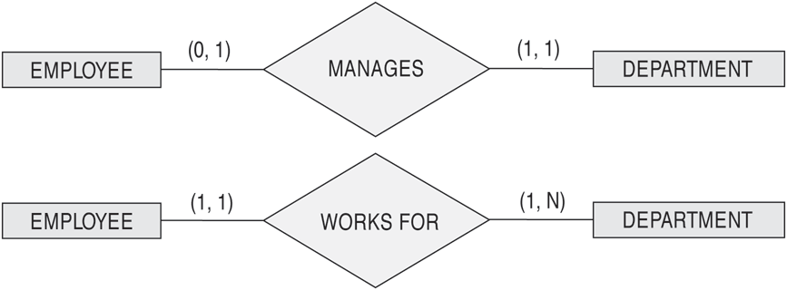

The (min,max) notation for relationship constraints
Read the min,max numbers next to the entity type and looking away from the entity type

Slide 91
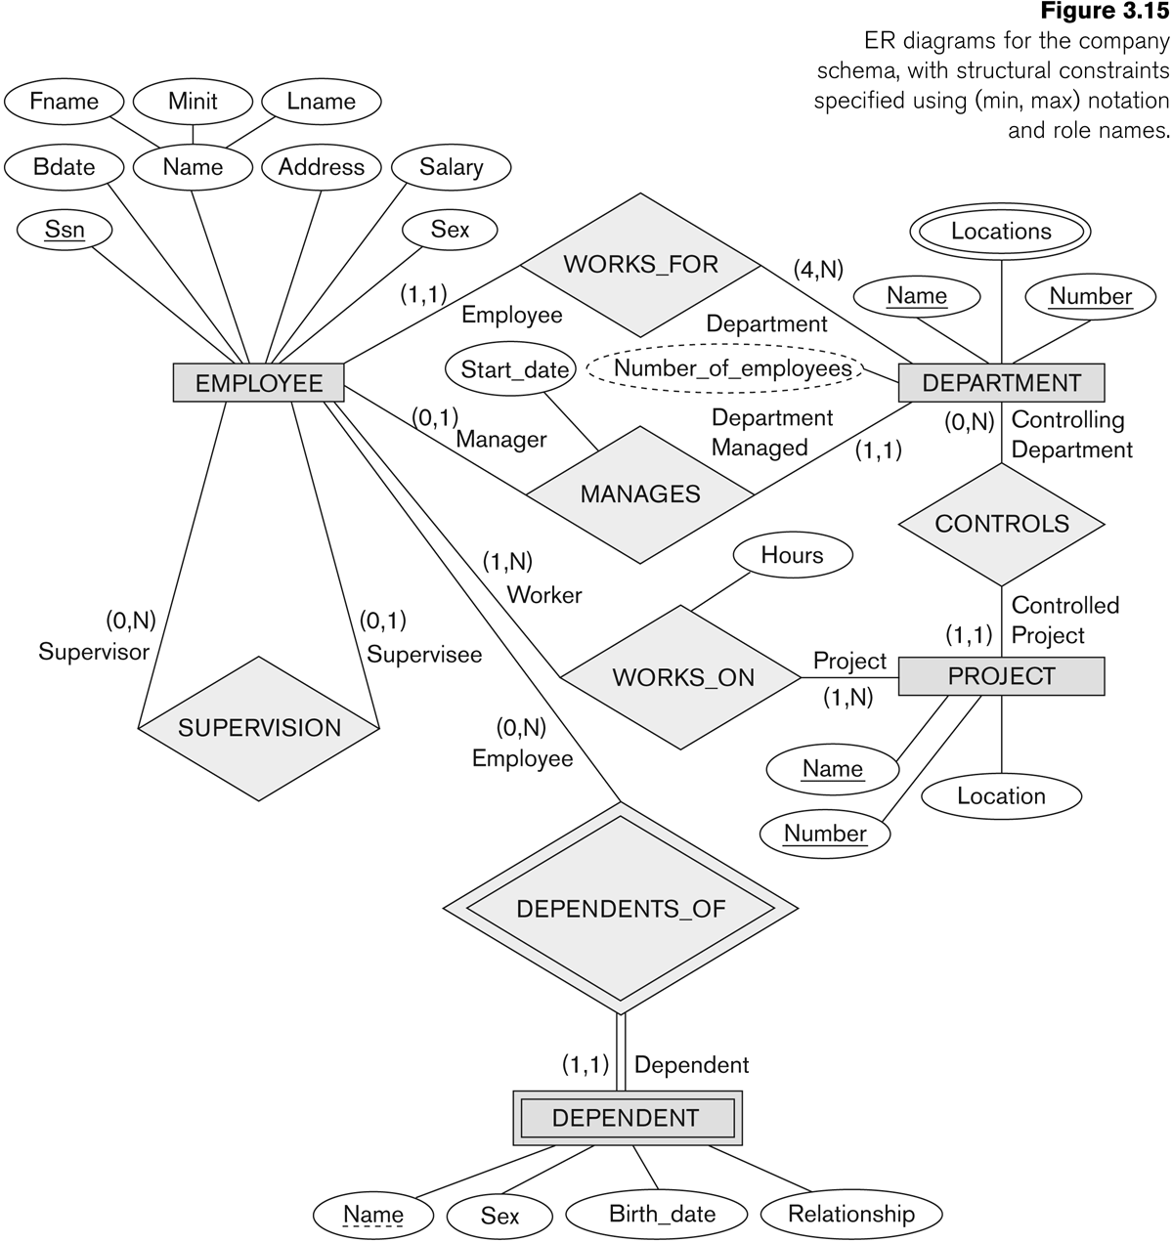
COMPANY ER Schema Diagram using (min, max) notation

Slide 92
Alternative diagrammatic notation
ER diagrams is one popular example for displaying database schemas
Many other notations exist in the literature and in various database design and modeling tools
Appendix A illustrates some of the alternative notations that have been used
UML class diagrams is representative of another way of displaying ER concepts that is used in several commercial design tools

Slide 93
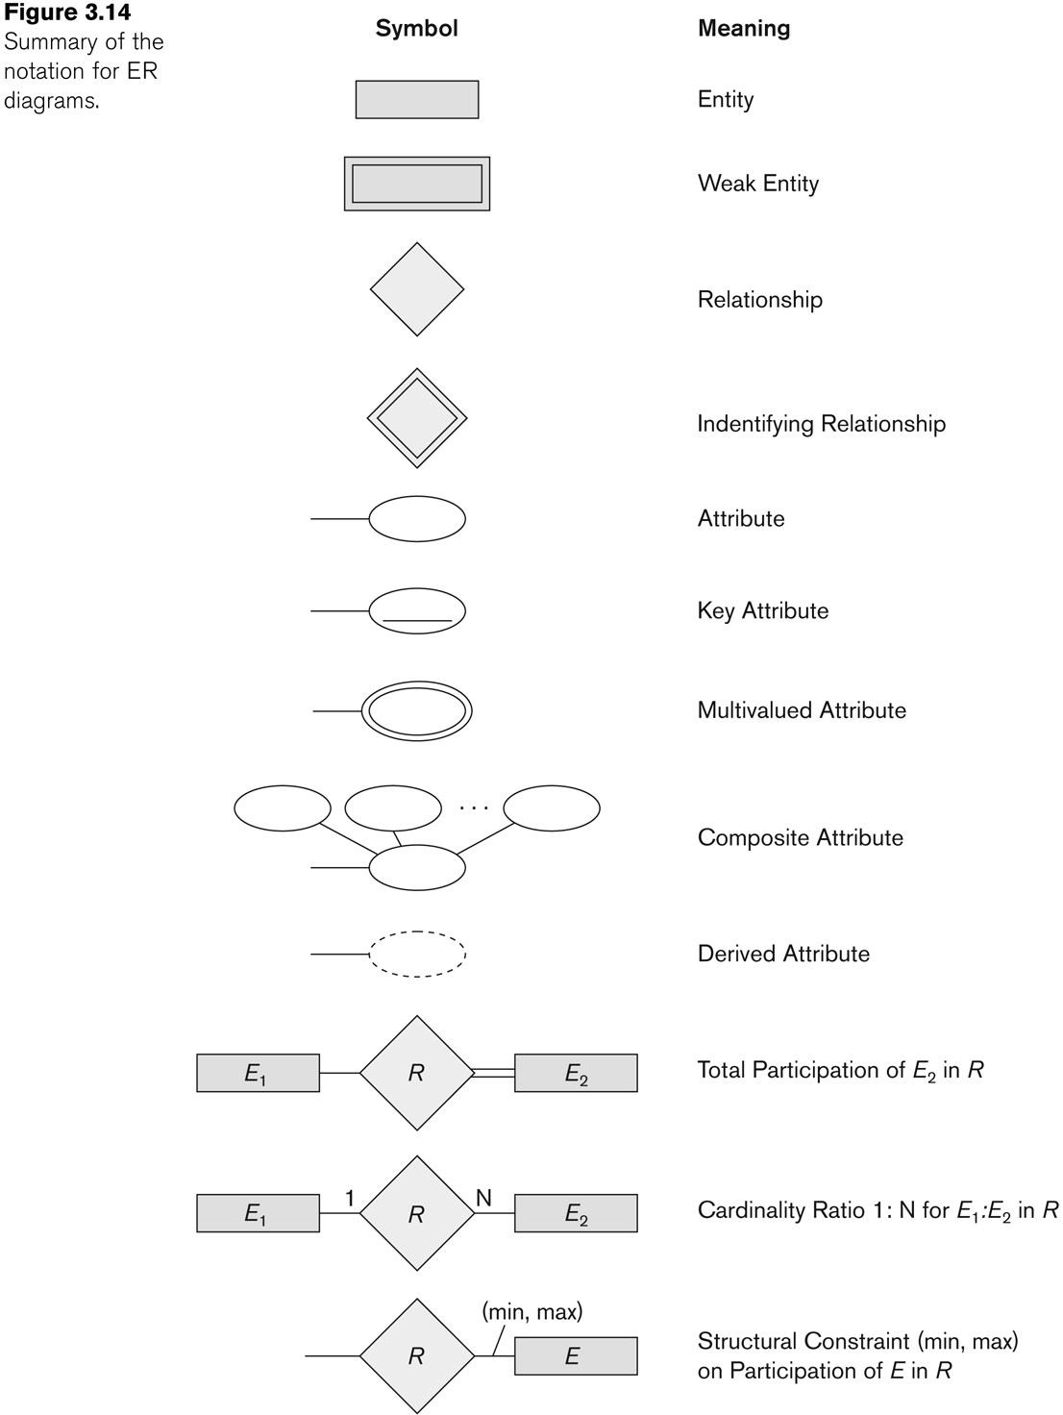
Summary of notation for ER diagrams

Slide 94
UML class diagrams
Represent classes (similar to entity types) as large rounded boxes with three sections:
Top section includes entity type (class) name
Second section includes attributes
Third section includes class operations (operations are not in basic ER model)
Relationships (called associations) represented as lines connecting the classes
Other UML terminology also differs from ER terminology
Used in database design and object-oriented software design
UML has many other types of diagrams for software design (see Chapter 12)

Slide 95
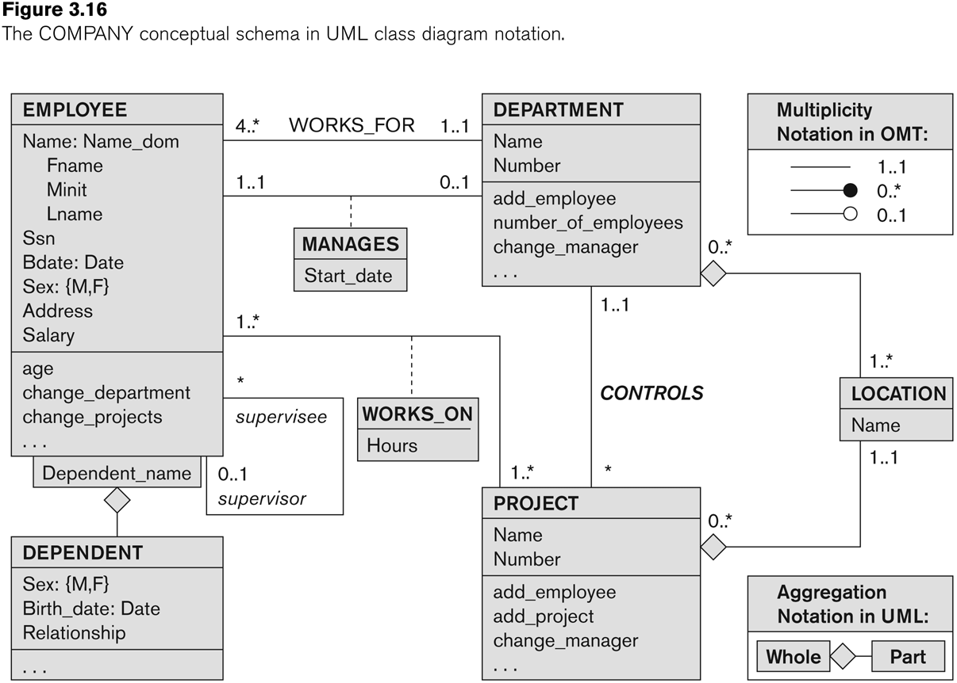
UML class diagram for COMPANY database schema

Slide 96
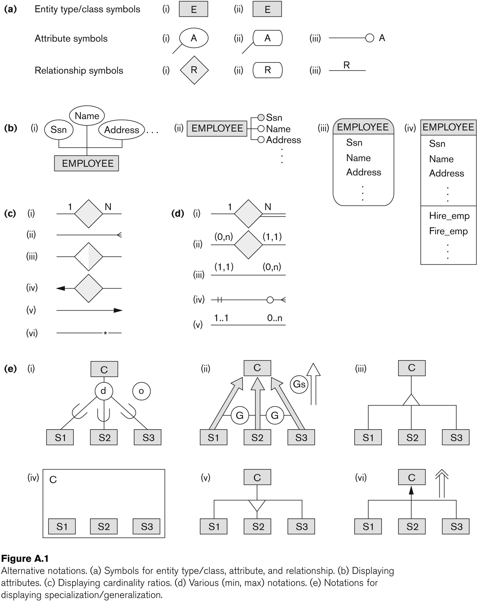
Other alternative diagrammatic notations

Slide 97
Relationships of Higher Degree
Relationship types of degree 2 are called binary
Relationship types of degree 3 are called ternary and of degree n are called n-ary
In general, an n-ary relationship is not equivalent to n binary relationships
Constraints are harder to specify for higher-degree relationships (n > 2) than for binary relationships

Slide 98
Discussion of n-ary relationships (n > 2)
In general, 3 binary relationships can represent different information than a single ternary relationship (see Figure 3.17a and b on next slide)
If needed, the binary and n-ary relationships can all be included in the schema design (see Figure 3.17a and b, where all relationships convey different meanings)
In some cases, a ternary relationship can be represented as a weak entity if the data model allows a weak entity type to have multiple identifying relationships (and hence multiple owner entity types) (see Figure 3.17c)

Slide 99
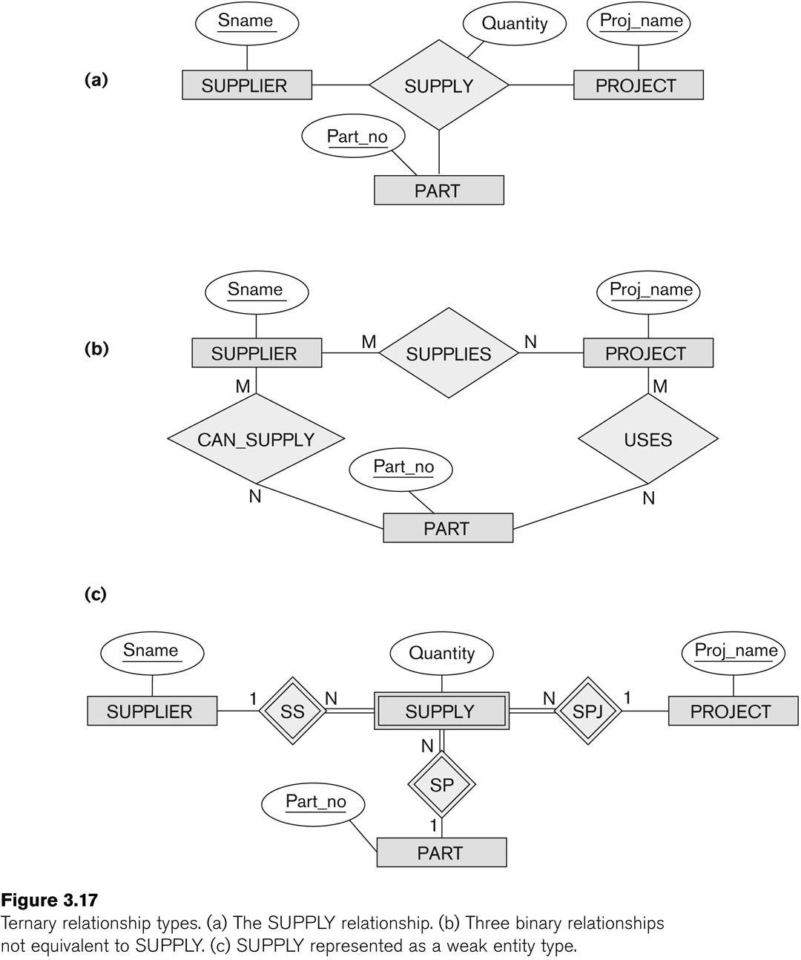
Example of a ternary relationship

Slide 100
Discussion of n-ary relationships (n > 2)
If a particular binary relationship can be derived from a higher-degree relationship at all times, then it is redundant
For example, the TAUGHT_DURING binary relationship in Figure 3.18 (see next slide) can be derived from the ternary relationship OFFERS (based on the meaning of the relationships)

Slide 101
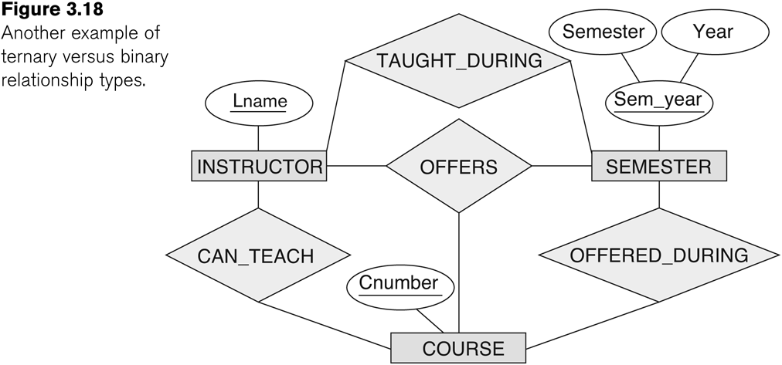
Another example of a ternary relationship

Slide 102
Displaying constraints on higher-degree relationships
The (min, max) constraints can be displayed on the edges – however, they do not fully describe the constraints
Displaying a 1, M, or N indicates additional constraints
An M or N indicates no constraint
A 1 indicates that an entity can participate in at most one relationship instance that has a particular combination of the other participating entities
In general, both (min, max) and 1, M, or N are needed to describe fully the constraints

Slide 103
Data Modeling Tools
A number of popular tools that cover conceptual modeling and mapping into relational schema design.
Examples: ERWin, S- Designer (Enterprise Application Suite), ER- Studio, etc.
POSITIVES:
Serves as documentation of application requirements, easy user interface - mostly graphics editor support
NEGATIVES:
Most tools lack a proper distinct notation for relationships with relationship attributes
Mostly represent a relational design in a diagrammatic form rather than a conceptual ER-based design
(See Chapter 12 for details)

Slide 104
Some of the Currently Available Automated Database Design Tools
COMPANY | TOOL | FUNCTIONALITY
Embarcadero Technologies | ER Studio | Database Modeling in ER and IDEF1X
 | DB Artisan | Database administration, space and security management
Oracle | Developer 2000/Designer 2000 | Database modeling, application development
Popkin Software | System Architect 2001 | Data modeling, object modeling, process modeling, structured analysis/design
Platinum (Computer Associates) | Enterprise Modeling Suite: Erwin, BPWin, Paradigm Plus | Data, process, and business component modeling
Persistence Inc. | Pwertier | Mapping from O-O to relational model
Rational (IBM) | Rational Rose | UML Modeling & application generation in C++/JAVA
Resolution Ltd. | Xcase | Conceptual modeling up to code maintenance
Sybase | Enterprise Application Suite | Data modeling, business logic modeling
Visio | Visio Enterprise | Data modeling, design/reengineering Visual Basic/C++

Slide 105
Extended Entity-Relationship (EER) Model
The entity relationship model in its original form did not support the specialization and generalization abstractions
Next chapter illustrates how the ER model can be extended with
Type-subtype and set-subset relationships
Specialization/Generalization Hierarchies
Notation to display them in EER diagrams

